Slide 1
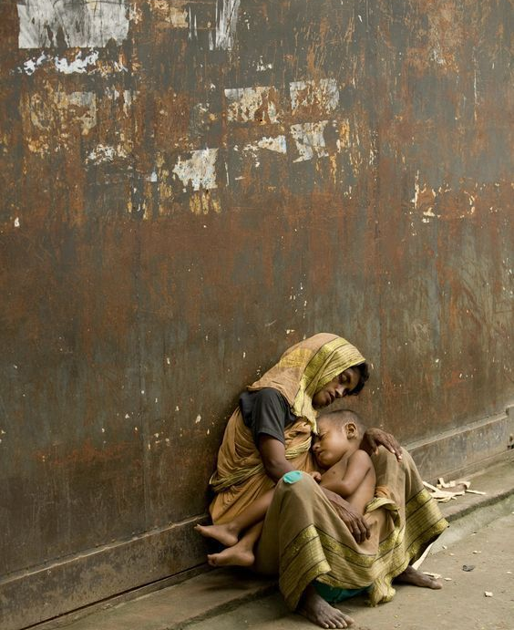
Homeless Minds: The Mental Health Crisis on the Streets
RAISHA KAFLE

Slide 2
CONTENT
INTRODUCTION
CHALENGES
IMPACT
STRATEGIES
THE ROLE OF ADVOCACY
CONCLUSION

Slide 3
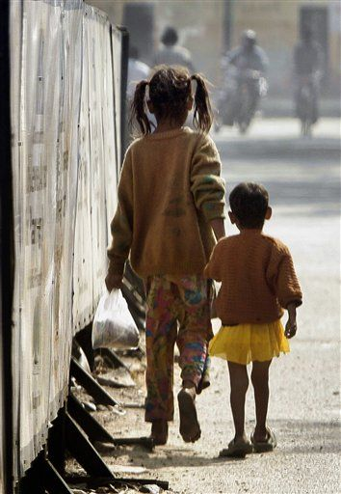
Introduction
Introduction Mental health is a critical aspect of an individual's overall well-being. Unfortunately, many homeless individuals struggle with mental health issues due to the numerous challenges they face daily. In this presentation, we will explore the impact of homelessness on mental health and the various strategies that can help mitigate these effects.

Slide 4

Challenges Facing Homeless Individuals
Challenges Facing Homeless Individuals Homelessness is associated with numerous challenges that can negatively affect mental health. These challenges include exposure to violence, trauma, and substance abuse. Additionally, homeless individuals often lack access to basic necessities such as food, shelter, and medical care. These challenges can lead to the development of mental health disorders such as depression, anxiety, and post-traumatic stress disorder (PTSD).

Slide 5

Impact of Homelessness on Mental Health
Homelessness can have a profound impact on mental health. Studies have shown that homeless individuals are at a higher risk of developing mental health disorders than the general population. Moreover, untreated mental health issues can further exacerbate the challenges of being homeless, making it even more difficult for individuals to find stable housing and employment.

Slide 6

Strategies for Addressing Mental Health in Homeless Populations
There are several strategies that can be employed to address mental health issues in homeless populations. One approach is to provide access to mental health services, including counseling and medication.
Another strategy is to implement supportive housing programs that provide stable housing and support services to homeless individuals with mental health issues.

Slide 7
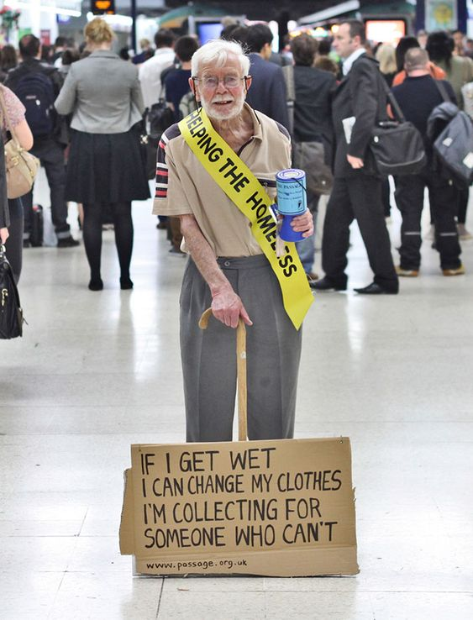
The Role of Advocacy
Advocacy plays a crucial role in addressing mental health issues in homeless populations. Advocates can raise awareness about the challenges facing homeless individuals and advocate for policy changes that improve access to mental health services and support programs.
Additionally, advocates can work to reduce the stigma surrounding mental illness, which can prevent individuals from seeking the help they need.

Slide 8

CONCLUSION
In conclusion, mental health is a significant issue facing homeless populations. The challenges of homelessness can exacerbate existing mental health issues and create new ones. However, there are strategies that can be employed to address these challenges, including providing access to mental health services and implementing supportive housing programs.
Furthermore, advocacy plays a crucial role in raising awareness about the challenges facing homeless individuals and advocating for policy changes that improve access to mental health services and support programs.

